Slide 1

Research Progress Record
Enmao Diao
Mar 20, 2020

Slide 2
Overview
Multimodal controller for generative models
New approach
Experiment
Result

Slide 3
Multimodal controller for generative models
Example
N: batch size, D: input channel size, K: output channel size, C: the number of modes (classes)
Input X (NxD), Output Y (NxK), Weight W (DxK), mode indicator C (NxC) (one-hot vector).
MC (Multimodal Controller) has a codebook E (CxK)
The formulation of multimodal controlled linear layer
Y = XW
Ymc = Y * (CE) (*: element-wise multiplication)

Slide 4
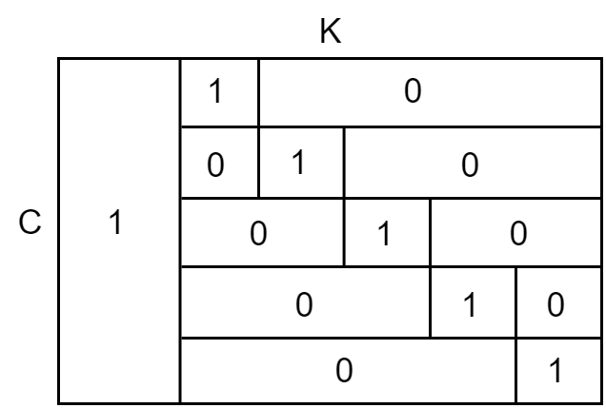
Multimodal controller for generative models
Approach
The old and new approach differs from the way of constructing codebook E
Old approach
A constant weight code with specified minimum distance

Slide 5
Multimodal controller for generative models
New approach
Old approach enforces that C <= K, and the effective channel size for each mode will also be affected which will degrade the performance
I attempt many different ways like
Randomly select Kc (Kc < K) channels (ones) for each mode
Construct the most distant C codes with hamming weight equal to Kc
Totally randomly initialized codebook with probability p
I find only the last one can generate images with a large number of modes

Slide 6
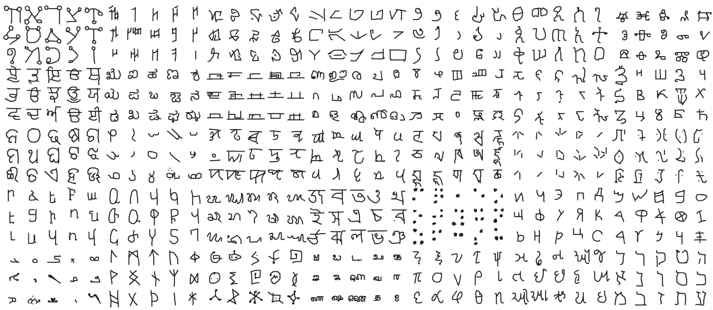
Multimodal controller for generative models
Experiments
Omniglot dataset (https://github.com/brendenlake/omniglot)
50 alphabets contain 1623 classes of characters and each character has 20 images
We aim to generate class-conditionally from such diverse dataset
The old approach is no longer suitable in this case, but our new approach has inherent randomness. Thus, we need to run random experiments to retrieve confidence interval.

Slide 7
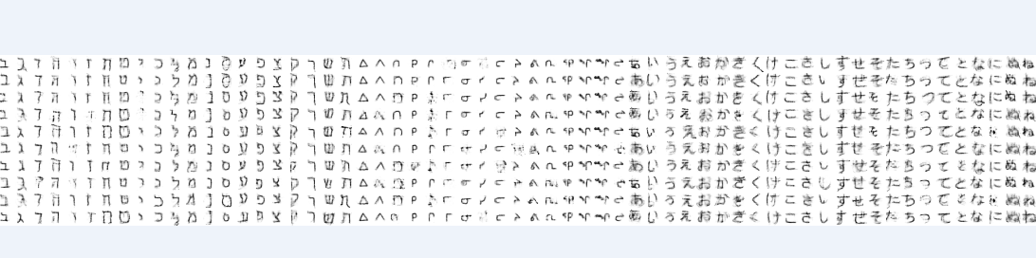
Multimodal controller for generative models
Result
Preliminary
I have results from MCVAE with p = {0.1, 0.2,…, 1} (Note p=1 reduced to vanilla VAE)
I only clip part of samples below

